Slide 1


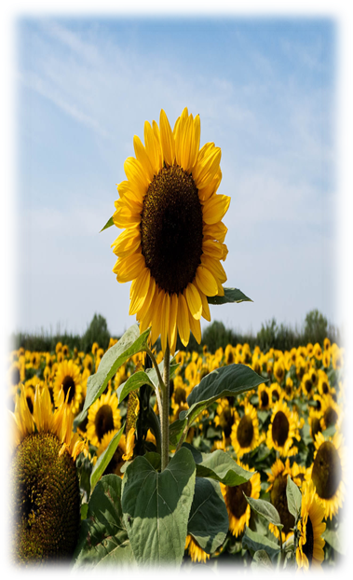

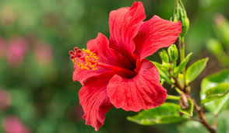



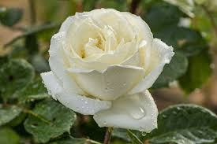
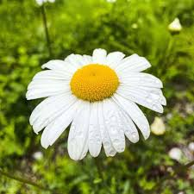





Touch to identify
Gallery
Name :- Sunflower
Scientific Name:- Helianthus
Location:- Ukraine is the world’s largest producer of the sunflower.
This is the Gallery of this application.
Here user can select image from gallery for identify plant.
This is useful for identify some unseen plant from internet.
User close this page using cross button.

